Slide 1
Chapter 8
Police Ethics and Police Deviance

Slide 2
Introduction
Police officers in the United States are given tremendous authority and wide latitude in using that authority
Many police officers complain that the press overdoes coverage of police corruption or brutality
The media operate under the philosophy that news is that which is different and not normal
The vast majority of men and women in our nation’s law enforcement agencies are extremely ethical

Slide 3
The Dilemma of Law Versus Order
Inherent conflict
Police face ethical dilemmas every day
Officers have to weigh many variables
Open to questions and criticism
Slippery slope to corruption
Notes:
Learning Objective 1: Identify some of the forms and extent of police deviance.

Slide 4
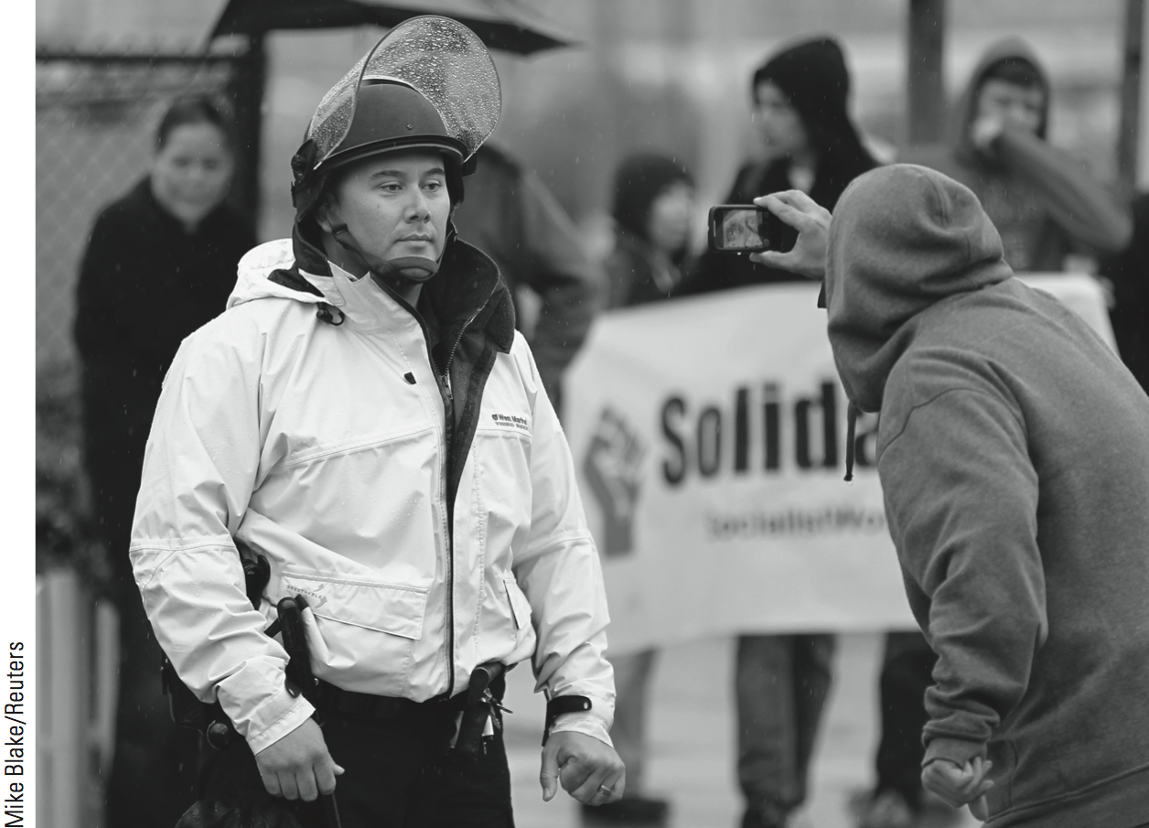
Review of the Police
Constantly under review by government agencies
Numerous national commissions
Knapp Commission, 1970
Judicial review
Review by citizens

Slide 5
Police Corruption
CORRUPTION MAKES GOOD BOOKS AND FILMS
Popular topic in literature and film
Art imitates life
Makes for good TV
Serpico
Training Day

Slide 6
Police Corruption
EXAMPLES OF POLICE CORRUPTION
“Rampart” scandal
Not limited to rank-and-file officers
Bernard Kerik, former NYC police commissioner

Slide 7
Police Corruption
REASONS FOR POLICE CORRUPTION
Individual officer explanations
Social structural explanations
Neighborhood explanations
The nature of police work
The police organization
The police subculture
Notes:
Learning Objective 2: Explain various reasons for police corruption, including why corruption may be more likely in policing than in other professions.

Slide 8
Police Corruption
TYPES AND FORMS OF CORRUPTION
Grass-eaters: more passive, accept what is offered
Meat-eaters: more aggressive, seek out
Gratuities
Bribes
The “rotten apple” theory

Slide 9
Police Corruption
NOBLE CAUSE CORRUPTION
Officer bends the rules to attain the “right” result
Noble cause corruption also called Dirty Harry syndrome
Not done for personal gain
Ends-oriented view of policing

Slide 10
Police Corruption
EFFECTS OF POLICE CORRUPTION
Undermines the public’s trust
Morale will suffer
Ruins a department’s reputation
Emotionally draining
Contributes to stress

Slide 11
Other Police Misconduct
DRUG-RELATED MISCONDUCT
Drug users and dealers make good targets
Typically involves small groups of officers
Profit is most frequent motive

Slide 12
Other Police Misconduct
SLEEPING ON DUTY
Fatigue issues
Night shift issues
Sleep interrupted
Court appearances
Meetings
Can be hazardous

Slide 13
Other Police Misconduct
POLICE DECEPTION
Police deception covers wide range of misconduct
Perjury in court (“testilying”)
Circumventing rules regarding searches and seizures
Falsifying police reports
Clearing cases wrongfully
Making up confessions

Slide 14
Other Police Misconduct
SEX-RELATED MISCONDUCT
Serious offense against public trust
Incorporates many behaviors
Behavior can signal a potential problem
Use position of authority
Victims are fearful of retribution

Slide 15
Other Police Misconduct
DOMESTIC VIOLENCE IN POLICE FAMILIES
May be more prevalent than in general population
Traditionally has been a hidden problem
Handled informally
Economic future at risk if reported

Slide 16
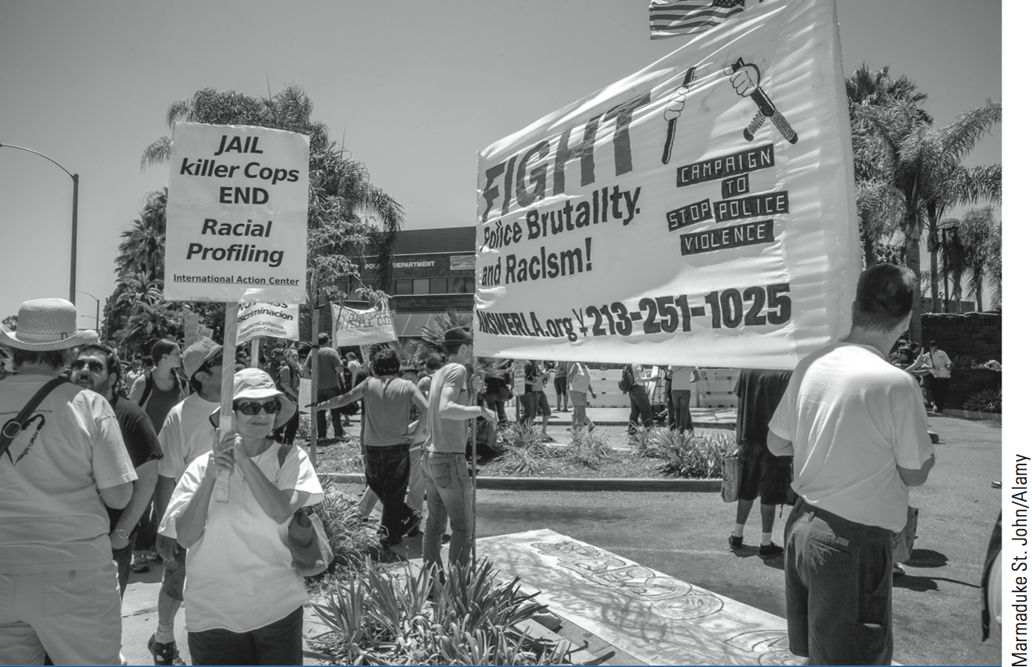
Biased-Based Policing
Biased-based policing is critical issue to the American people
Equal protection
Equal opportunity
Racial profiling
Validity of stops questioned
Aftermath of 9/11
Notes:
Learning Objective 2: Explain various reasons for police corruption, including why corruption may be more likely in policing than in other professions.

Slide 17
Police Brutality
Use of force is a necessary part of police work
The slippery slope
Media attention
Noble cause corruption
Ends-oriented thinking
Notes:
Learning Objective 3: Discuss various responses to police brutality and corruption, both within departments and agencies and in the community.

Slide 18
Responses to Police Corruption
INVESTIGATIONS
Internal affairs division
Integrity test
DISCIPLINE AND TERMINATION
“Clean house”
Administrative leave
Decertification

Slide 19
Responses to Police Corruption
PREVENTIVE ADMINISTRATIVE ACTIONS
Hiring and screening process
Policy and procedure manual
Training
CITIZEN OVERSIGHT
Citizen oversight or civilian review
Basic models of oversight systems
Best system needs to be chosen

Slide 20
Police Civil and Criminal Liability
STATE LIABILITY
Police may be sued in state civil courts
Civil liability and criminal liability
Intentional or negligence torts
Administrative liability
FEDERAL LIABILITY
Civil rights grounds
1983 suits
Subject to administrative liability
Notes:
Learning Objective 4: Explain how officers can be held legally liable for their conduct, including the reasons for and results of legal action brought against officers.

Slide 21
Police Civil and Criminal Liability
REASONS FOR SUING POLICE OFFICERS
Use of excessive force
Failure to aid private citizens
False arrest
Negligent care of suspects

Slide 22
Police Civil and Criminal Liability
EFFECTS OF LAWSUITS ON POLICE DEPARTMENTS
& OFFICERS
Vehicle for stimulating reform
Force improvements
Discipline
Policy change
Training
Reluctance to take action by officers
Notes:
Learning Objective 5: Describe the effects of allegations of corruption on the officer, the agency, law enforcement in general, and the community.

Slide 23
Police Civil and Criminal Liability
THE EMOTIONAL TOLL OF POLICE LAWSUITS
Complaints generate media attention
Internal affairs investigations
“No comment” viewed negatively
Feeling abandoned and alone
Worst-case scenario is suicide
Notes:
Learning Objective 5: Describe the effects of allegations of corruption on the officer, the agency, law enforcement in general, and the community.

Slide 24
Summary
The media highlights incidents of police corruption or misconduct.
Police corruption has been around for many years.
Noble cause corruption refers to situations where officers bend the rules to attain the “right” result.
Although use of force is a necessary part of the job, it must be reasonable and appropriate.
Citizen oversight is often demanded by the community.
Only a very small percentage of officers are involved in misconduct.

